Slide 1


FOREU4ALL Discussion Paper
European Universities Alliances:
Beating Heart of Europe’s Future
Way forward

Slide 2
Key messages Discussion Paper
Deep collaboration as key strength and much-needed partnership model;
Alliances advance the fifth freedom as proposed by Enrico Letta;
Alliances are essential for achieving European competitiveness, the ERA, the EEA and the Union of Skills;
Diversity and inclusiveness as bridges across Europe’s knowledge square;
Alliances transform cooperation (many examples across various dimensions);
Vision for the next MFF. Nurture the diversity and need for:
  Long-term support;
  Holistic approach;
  Non-directional support;
  Flexible support;

Slide 3
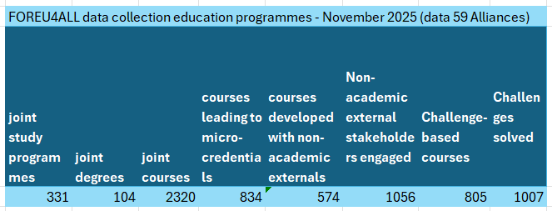
Educational programmes developed by Alliances

Slide 4



Communication and Dissemination
Stress that it is a discussion paper (not a policy paper)
Stress that it was co-created in the FOREU4ALL community of practice
Spread the word

Slide 5


Communication and Dissemination
Individual members of your own alliance (Leadership, academic staff, management, students and their representations)
Member states, respective ministries and their representatives (federal and regional)
Representatives at EU level (MPs)
Associate partners

Slide 6
Communication and Dissemination
Paper was sent to EVPs Minzatu and Zaharieva and their Cabinets as well as the respective DGs
Paper was sent to associations etc.

